Slide 1
Quick Point Of Sales
Features and Information Brochure

Slide 2
Contents
Company Profile
QuickPOS Introduction
QuickPOS in different business
QuickPOS Features
Demo Images
Quick POS www.quicklinqs.com Phone.03024759550

Slide 3
Company Profile
Quicklinqs was established in 2015 to provide information technology solutions for small to medium-sized businesses. Our mission from the very first day has been to cultivate professional relationships with our clients to provide effective and reliable information technology solutions for their needs. The team at Quicklinqs is equipped with a highly developed skillset. At Quicklinqs, we guarantee rapid, reliable and robust information technology solutions that work.
Quicklinqs Services:
Website, Software & Mobile Apps development
Corporate/Branded SMS
Digital Marketing & SEO
Ecommerce & Online Sales Management
IT support
Domain and Hosting
Quicklinqs Products:
QuickPOS Personal edition
QuickPOS Enterprise edition
QuickLease
QuickAccounts
Quicklinqs Customers:
Letter First Gmbh (Germany)
Amanat Pak (Malaysia)
Byeyle.de (Germany)
3 Brothers Restaurants Chain (Pakistan)
Inam Cosmetic Stores (Pakistan)
AladinScan (Kuwait)
Aewaa (Kuwait)
Taisty (Pakistan)
Jan Group (Pakistan)
CJS Co (Pakistan)
Quick POS www.quicklinqs.com Phone.03024759550

Slide 4
QuickPOS Introduction
QuickPOS includes a comprehensive list of features that are ideally suited for quick service. Make quick and easy sales, manage your loyalty program and inventory all from your computer, smartphone or tablet.
Build your customer base and stay in touch. Send messages and e-receipts to your customers and collect valuable feedback.
Make informed business decisions based on visual analytical reports. Retrieve your sales report and track your business growth. Pay monthly, with no string attached. Subscribe longer to save more.
Whether you’re in retail or wholesale, Inventory is one of your biggest expenses. Can you afford not to manage it effectively? QuickPOS helps you understand cost of goods sold and stock movement. You can strategically order stock to keep up with demand without overstocking. From a single inventory, sell your stock in-store and online. See your inventory count updated in real time.
Quick POS www.quicklinqs.com Phone.03024759550

Slide 5
QuickPOS in different business
QuickPOS can be easily implemented in these businesses
Retailer
Distributors
Wholesalers
Services sellers
Grocery Stores
Restaurants
Cosmetic Stores
Garments Stores
Bookshops
Shoes Stores
Medical Stores
Small Companies
Small Manufacturing Units
Quick POS www.quicklinqs.com Phone.03024759550

Slide 6
QuickPOS Features
Easy to Use
QuickPOS is easy to use and user friendly. In just 30 minutes, you can learn to use software.
Inventory
Organize products by category, type, season, sale, and more. Use smart collections to automatically sort products based on vendor, price, and inventory level. Manage your entire inventory with software. Track stock counts, and automatically stop selling products when inventory runs out.
Sales and Purchase
Quick entering barcode enabled sales, purchases, orders and quotes. Easy and user friendly interface enables fast operation.
Customers Management
Your customers’ information is synced with software, so their order history can be referenced or tracked – no matter where the order was placed.
Vendors Management
Easy to maintain vendors base. Track vendor purchases, returns and ledger.
Quick POS www.quicklinqs.com Phone.03024759550

Slide 7
Automatic Accounting Journal Entries
QuickPOS has built-in accounting functionality. Automatics journal entries enable fast and automatic accounting of your business
Ledger
Maintain customers, vendors and staff accounts right form software.
Expenses Management
Keep track of all of your expenses. Automated Cost of Goods Sold entries in software. You can manage expenses at any level.
Equity Management
Equity, Capital Share management options provided in software.
Multi Roles and Users
Add as much as roles and users on software.
Quick POS www.quicklinqs.com Phone.03024759550

Slide 8
Local, Web or Cloud Deployment
You can use software on local computer without internet or you can deploy software on web/cloud and can access from computer/mobiles.
Branded SMS through software
Sales notifications and Promotional branded SMS can be integrated on software.
Invoicing and Billing and Receipts
Print your invoices, bills and payment receipt from software .You can print pdf or on thermal printer.
Quick POS www.quicklinqs.com Phone.03024759550

Slide 9
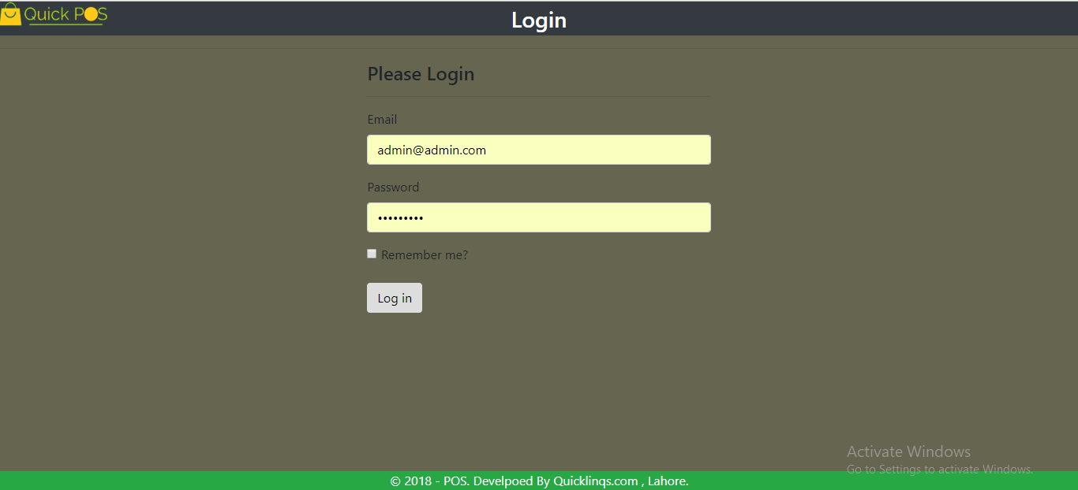
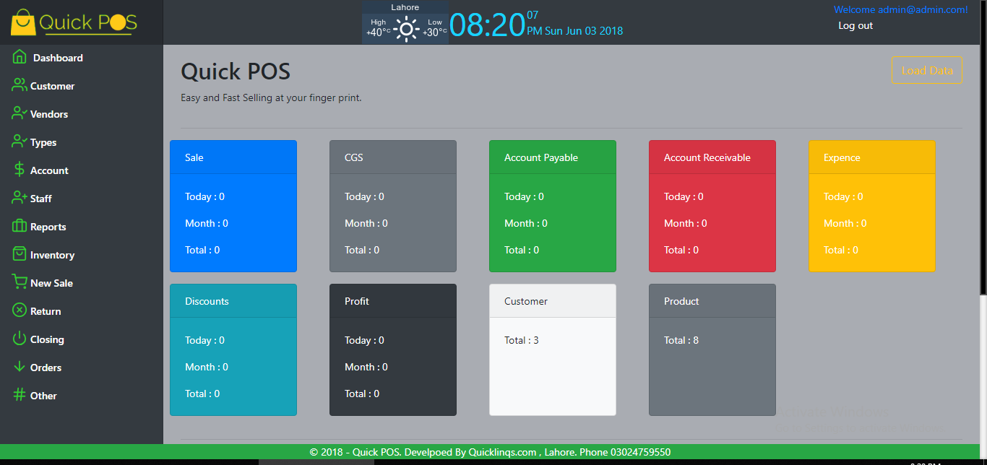
Demo Images
Login
Dashboard
Quick POS www.quicklinqs.com Phone.03024759550

Slide 10
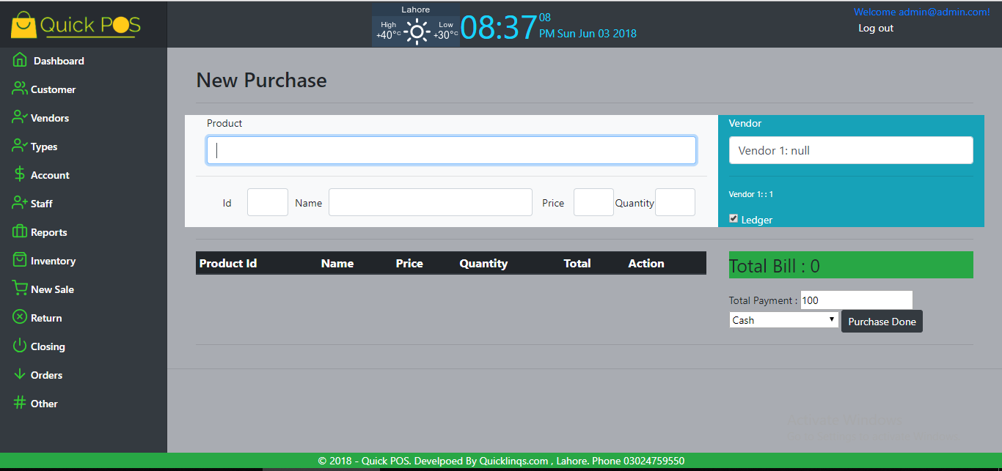
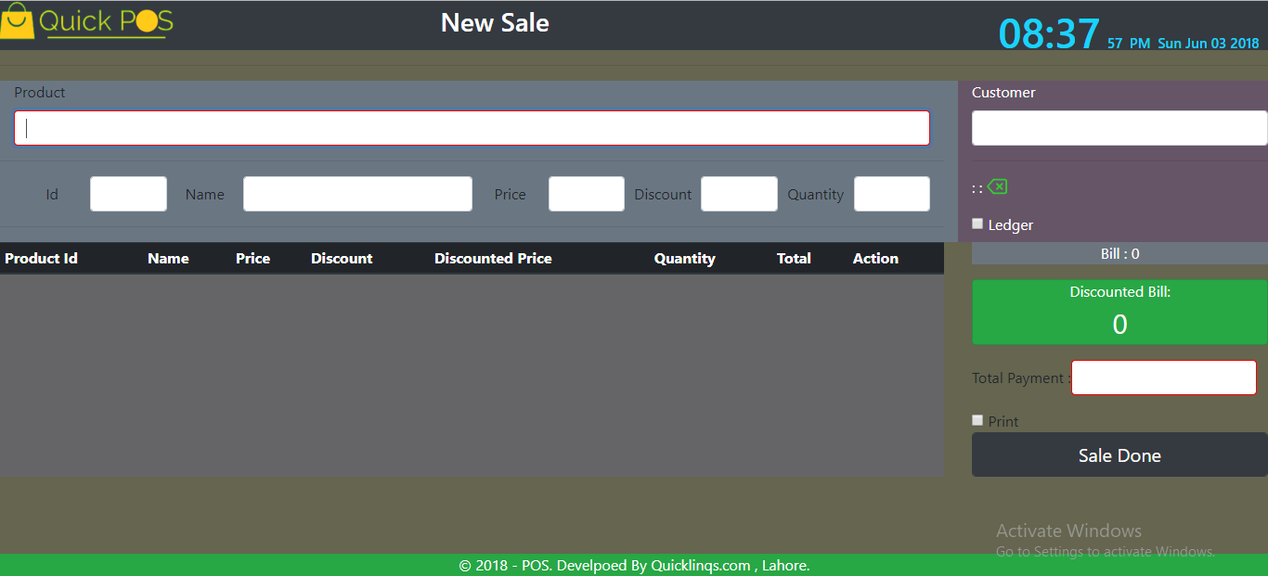
Purchase
Sale
Quick POS www.quicklinqs.com Phone.03024759550

Slide 11
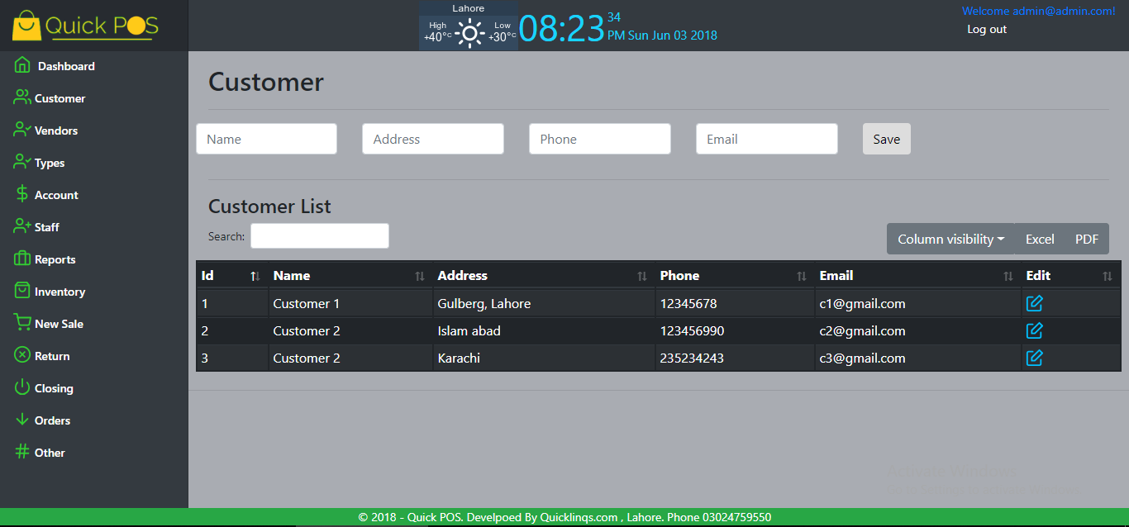
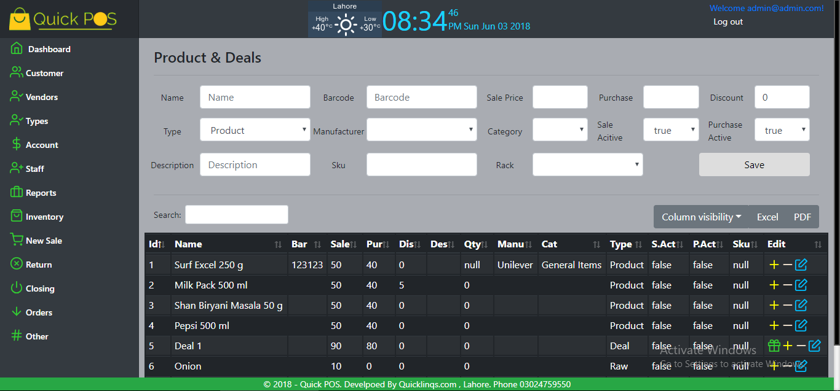
Customer
Product
Quick POS www.quicklinqs.com Phone.03024759550

